Slide 1

Insights into Vehicle Safety: Analyzing NHTSA Complaints Data

Slide 2

Insights:
NHTSA Complaints Database: A comprehensive dataset detailing vehicle complaints across the U.S.
Trends Over Time: Evaluating how complaint numbers have evolved year by year.
Geographic Analysis: Investigating how complaint rates vary across different states.
Manufacturer Analysis: Comparing complaint rates among various vehicle manufacturers and their makes.
Vehicle Age Analysis: Exploring the relationship between the age of vehicles and the frequency of complaints.
Significance:
This analysis aims to uncover patterns that can provide insights into:
Safety Concerns: Identifying manufacturers or regions with higher complaint rates, which may indicate safety issues.
Quality Control: Highlighting potential areas for improvement in vehicle design and manufacturing processes.

Slide 3
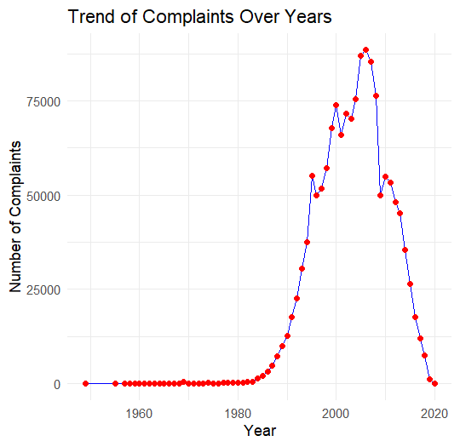
Left Skewed Distribution: The graph is left skewed, indicating that most of the data is concentrated on the right side.
Focus on Recent Decades: The significant increase in complaints occurs primarily in the last three decades, highlighting the importance of analyzing this period for current trends and issues.

Slide 4
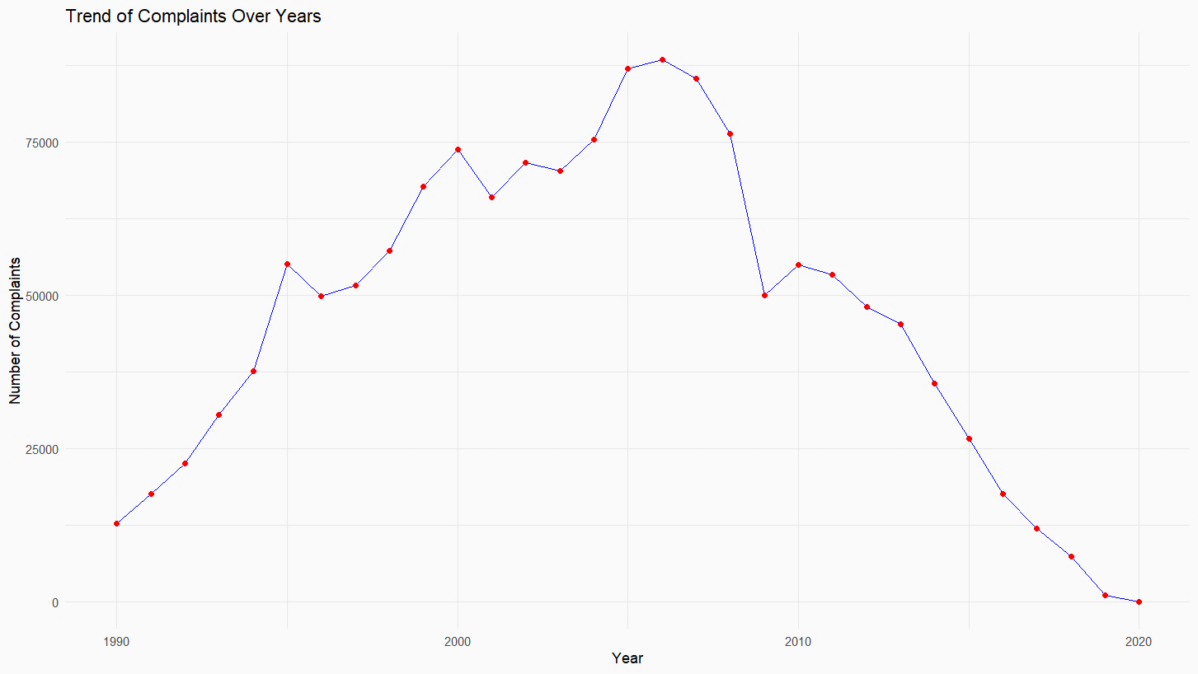
Non-Linearity: The trend is non-linear, with noticeable fluctuations in the number of complaints over time.
2008-09 Dip: There is a notable dip in complaints between 2008-2009. This could be due to various factors such as economic conditions or changes in reporting mechanisms.
2010 Gradual Decrease: After peaking, there is a gradual decrease in complaints starting around 2010. This decline might indicate improvements in vehicle safety or changes in consumer behavior.
Trend Of Complaints Over Years:

Slide 5
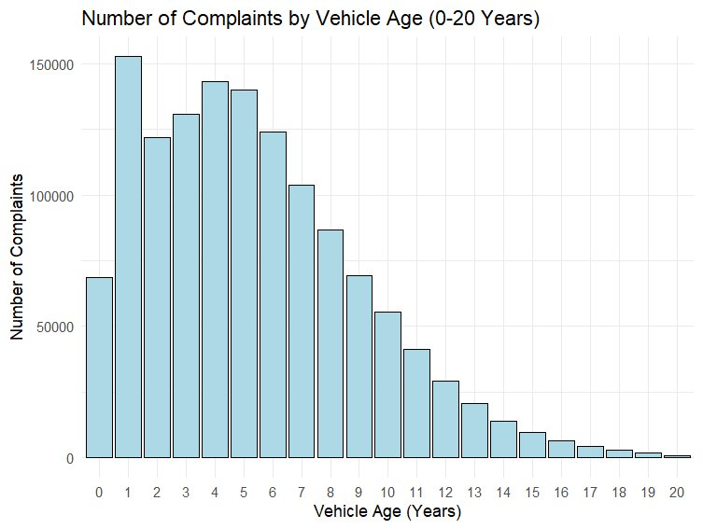
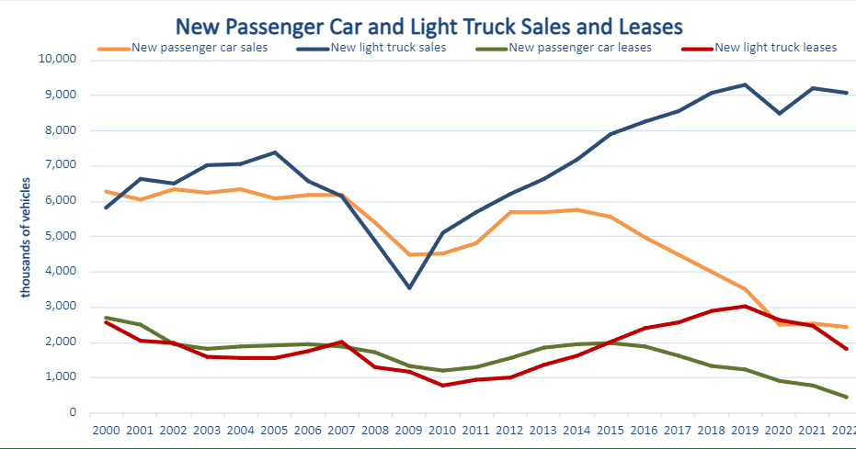
Vehicle Age Analysis:
Bureau of Transportation Statistics:

Slide 6
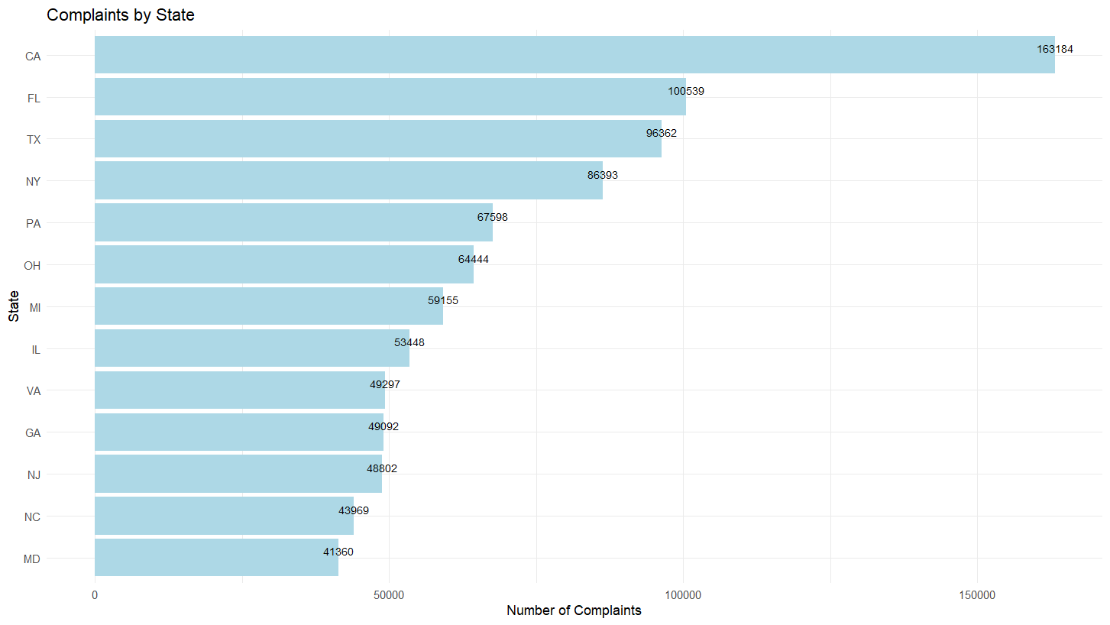
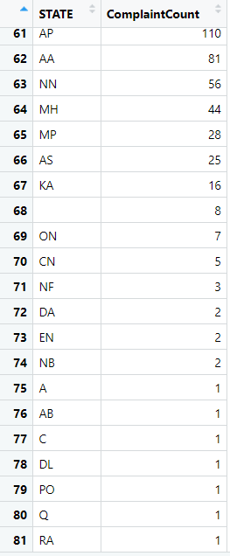
Geographic Distribution:
Aggregated the complaints by state and identified the top 13 states with the highest number of complaints.
Filtered and removed states with <1000 complaints.

Slide 7
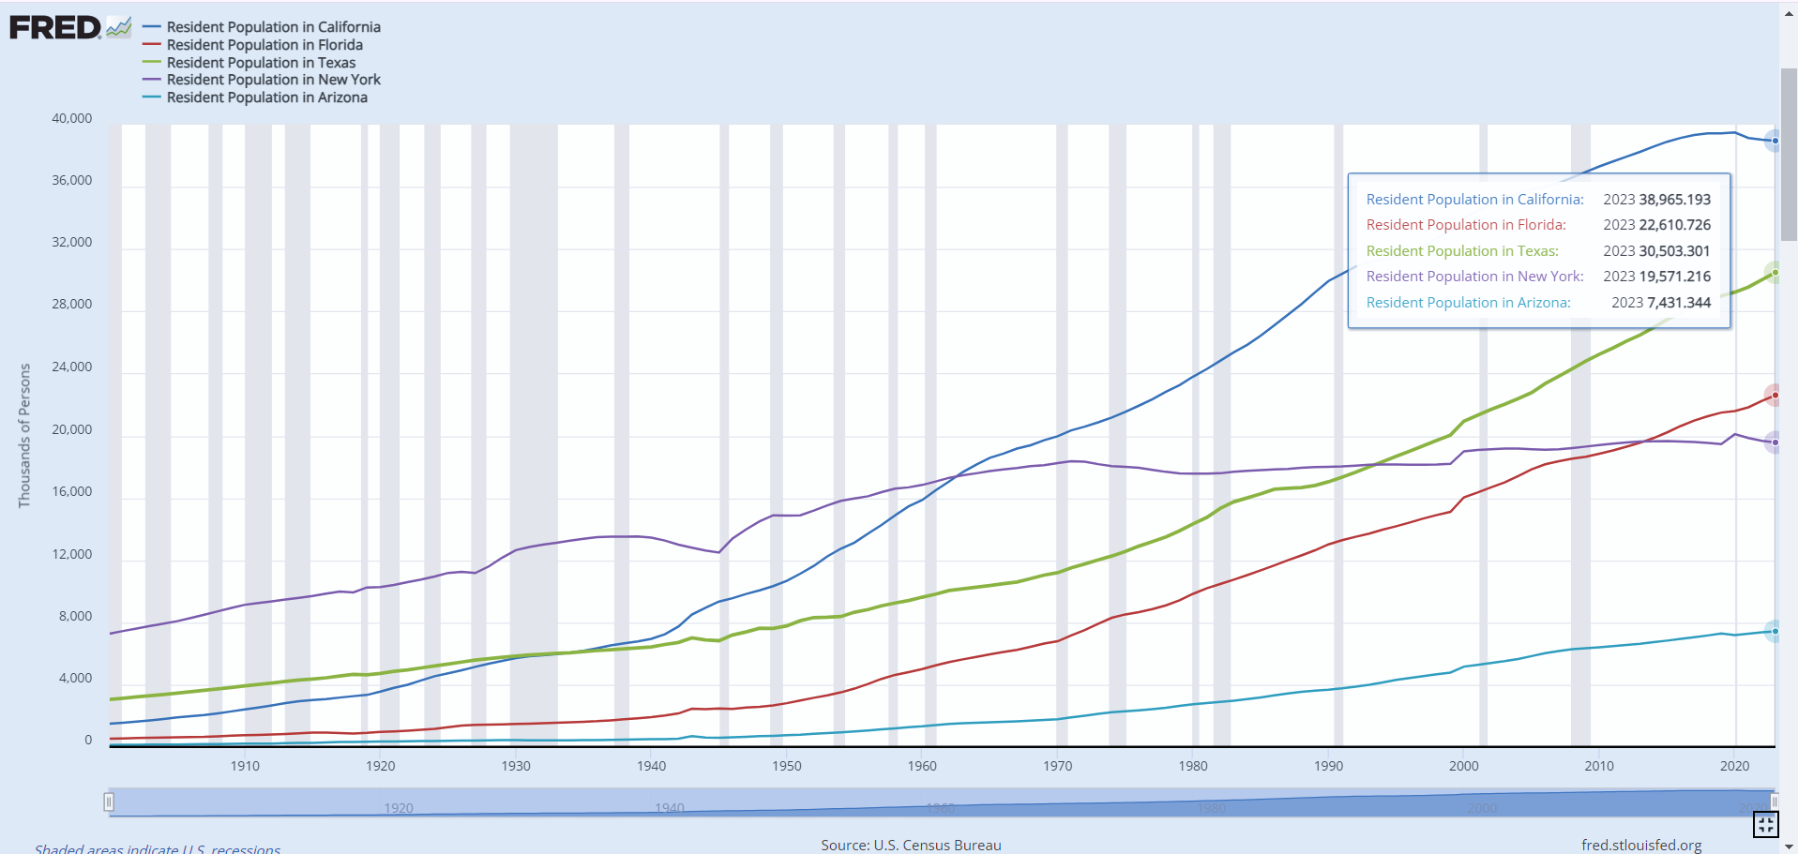
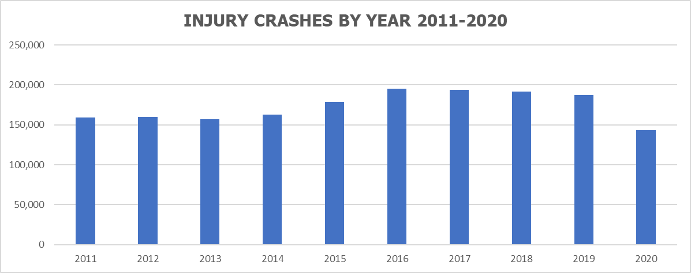
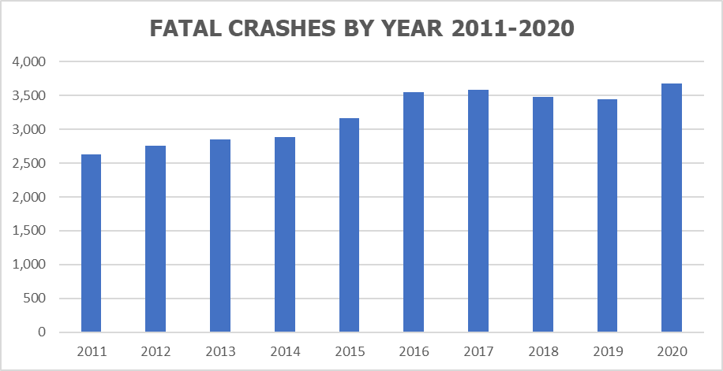
US Census Bureau:
California Fatality and Injury Statistics (SWITRS)

Slide 8
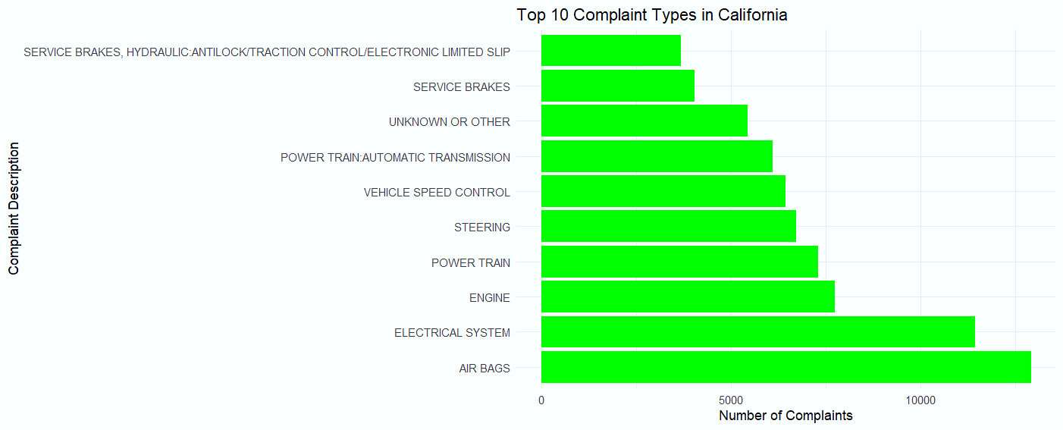
Are there particular states or cities with higher complaint frequencies?
What types of defects are most prevalent in those regions?

Slide 9
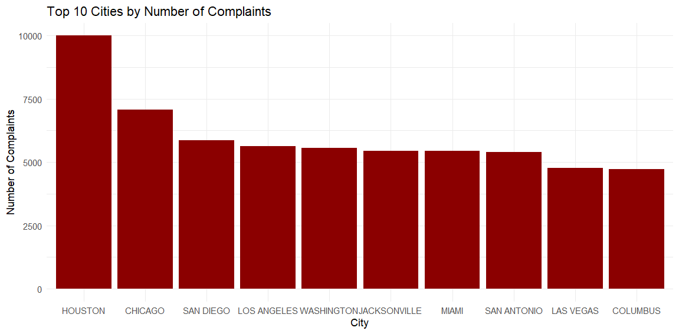
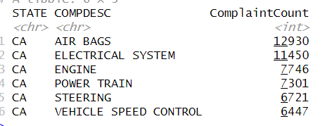
Why It Matters: Understanding the geographic distribution and the nature of defects in certain regions can help manufacturers and regulators focus their attention on regions that might have systemic issues.
Cities with the most complaints are identified, which can reveal local areas with concentrated issues.
A few cities might stand out, such as Houston (Car city) with significant car usage.
We also analyzed the types of complaints across the top states. The focus was on identifying the most frequent complaint types (defects) in each state.

Slide 10
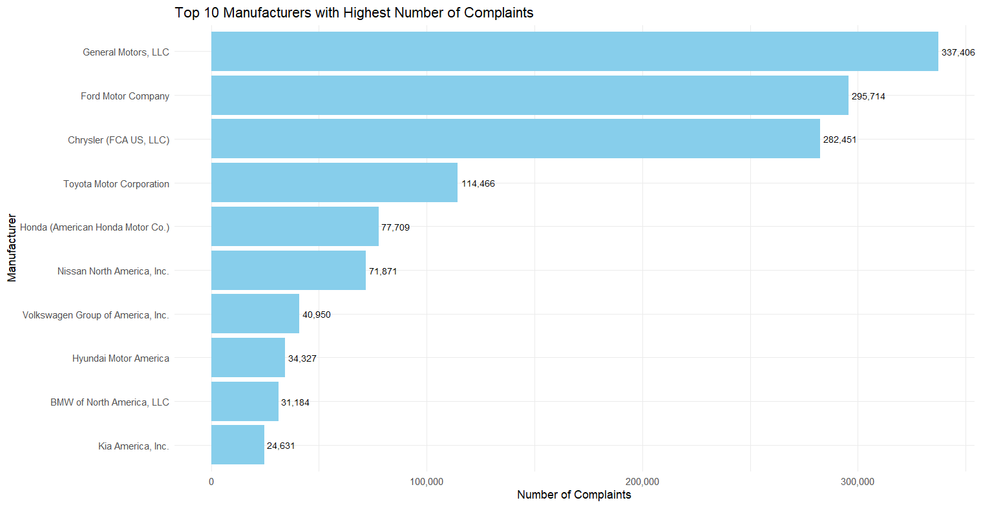
Manufacturer Analysis:

Slide 11
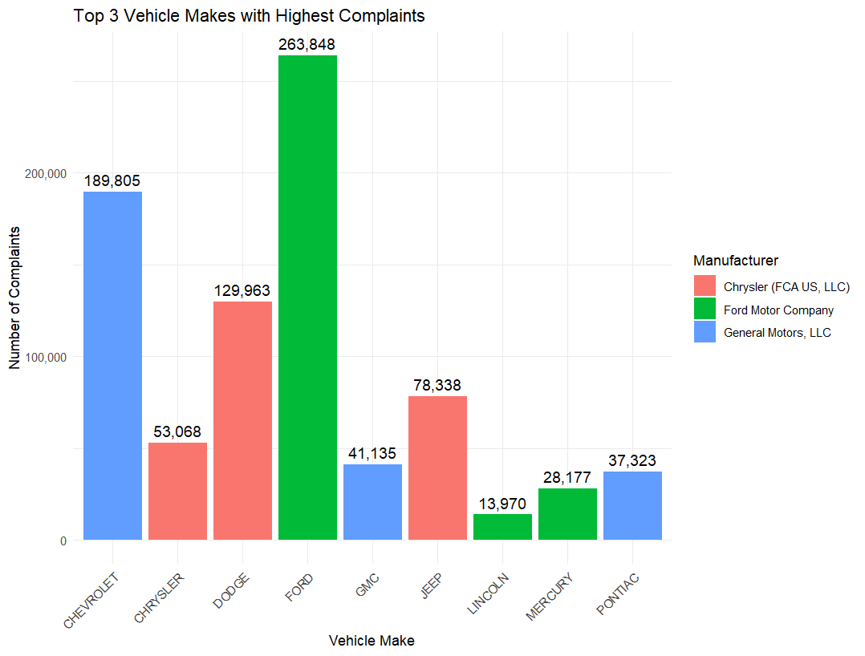
Which manufacturer have the highest number of complaints?
What types of defects are more commonly reported for each manufacture?

Slide 12
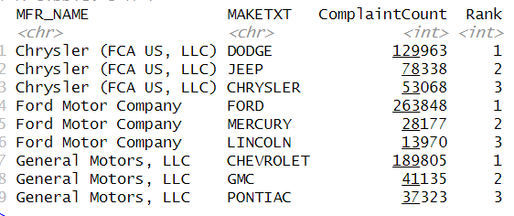
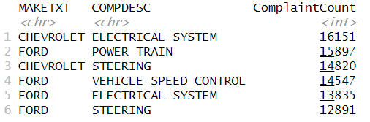
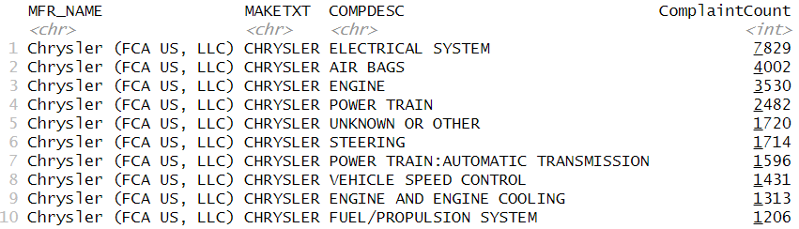
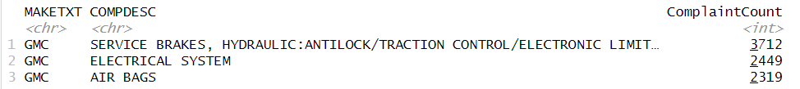

Slide 13
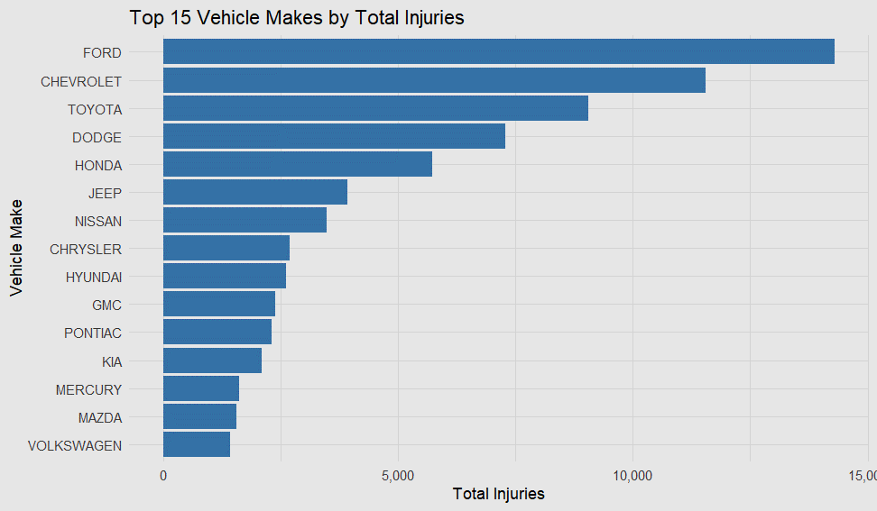
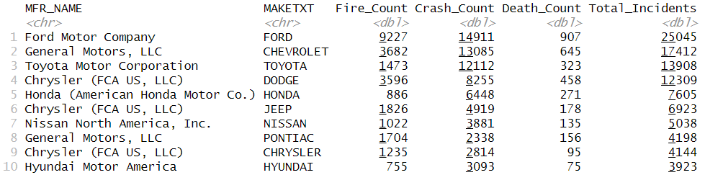
Top Manufacturers by Incident Counts:
A Consumer Report analysis of industry data shows that the hood height of passenger trucks has increased by an average of at least 11 percent since 2000 and that new pickups grew 24 percent heavier on average from 2000 to 2018. On some heavy-duty trucks, such as the Ford F-250, the front edge of the hood is now 55 inches or more off the ground—as tall as the roof of some sedans. New CR data shows that drivers have poorer front sight lines, creating a blind spot that can hide a pedestrian or smaller car right in front.
ThePhoto by PhotoAuthor is licensed under CCYYSA.

Slide 14
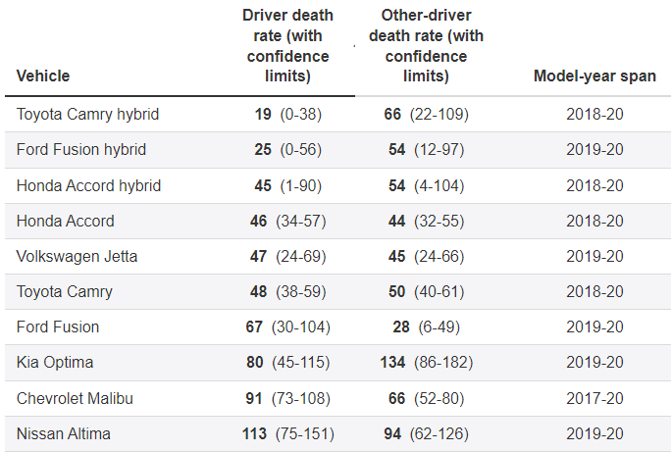
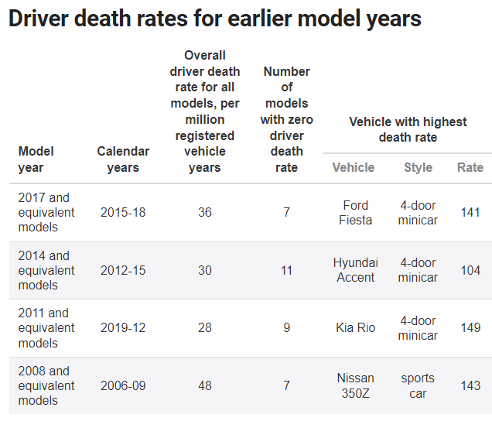
Insurance Institute for Highway Safety (IIHS):
How do we know that our analysis is reliable?

Slide 15

Future analysis:
Market Share Consideration.
Defect Severity and Safety Risks.
Time-to-Failure (TTF) Analysis.
Geographic Analysis & Climate Impact.
Complaint Trends by Vehicle Age.

